Slide 1

SDLC Using Agentic AI
Building an Adaptive AI Software Engineering Organization
Presented By:
Abhishek Raj (M.Tech Intern)
Guide:
M.B. Sai Charan (Scientist C)

Slide 2
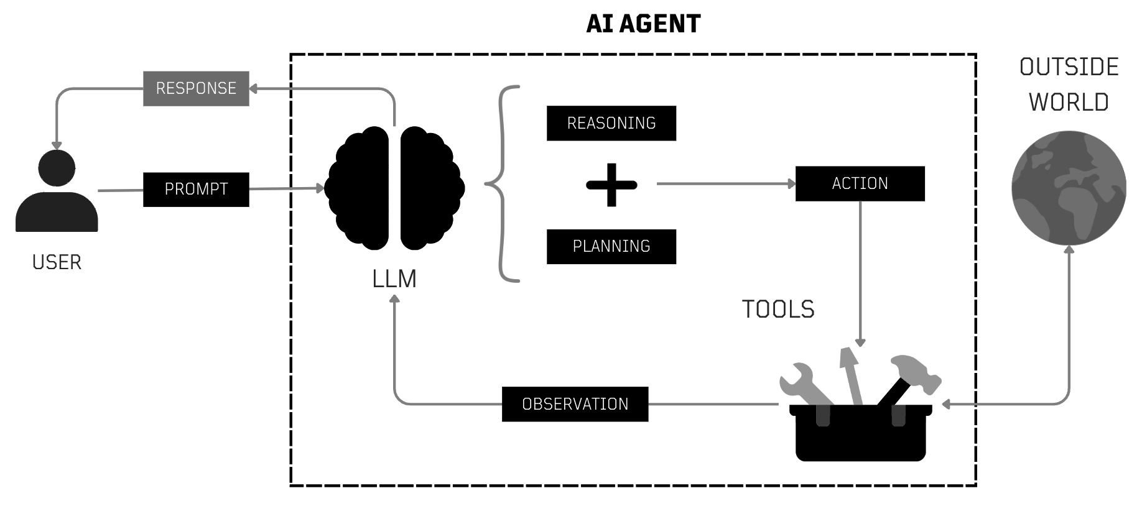
What is an AI Agent?
An AI agent is a system where an LLM operates in a loop: it receives observations from an environment (user messages, tool outputs, sensor data), reasons about what to do next, takes actions (tool calls, code execution, API requests), and iterates until a goal is achieved or it explicitly asks for human input.
An AI agent should have the following characteristics:
Persistence: An agent must remember what it has done, what failed, and what context was established—across turns, sessions, and even days.
Grounding: The agent must access up-to-date, domain-specific knowledge that was not present in its training data.
Action: The agent must interact with external systems—databases, APIs, file systems, browsers—through well-defined interfaces.
Coordination: Complex tasks often exceed what a single agent can handle; multiple specialized agents must collaborate, delegate, and negotiate.
Safety: Autonomous action requires guardrails, human oversight, and graceful degradation when the agent is uncertain. [6]

Slide 3
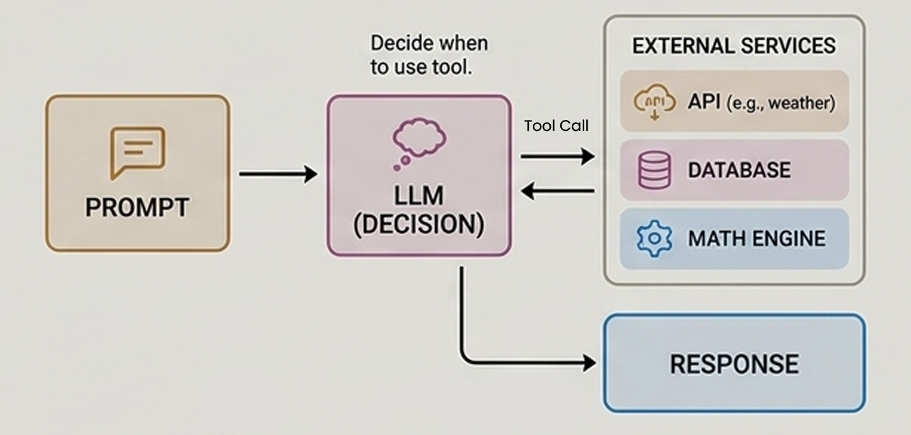
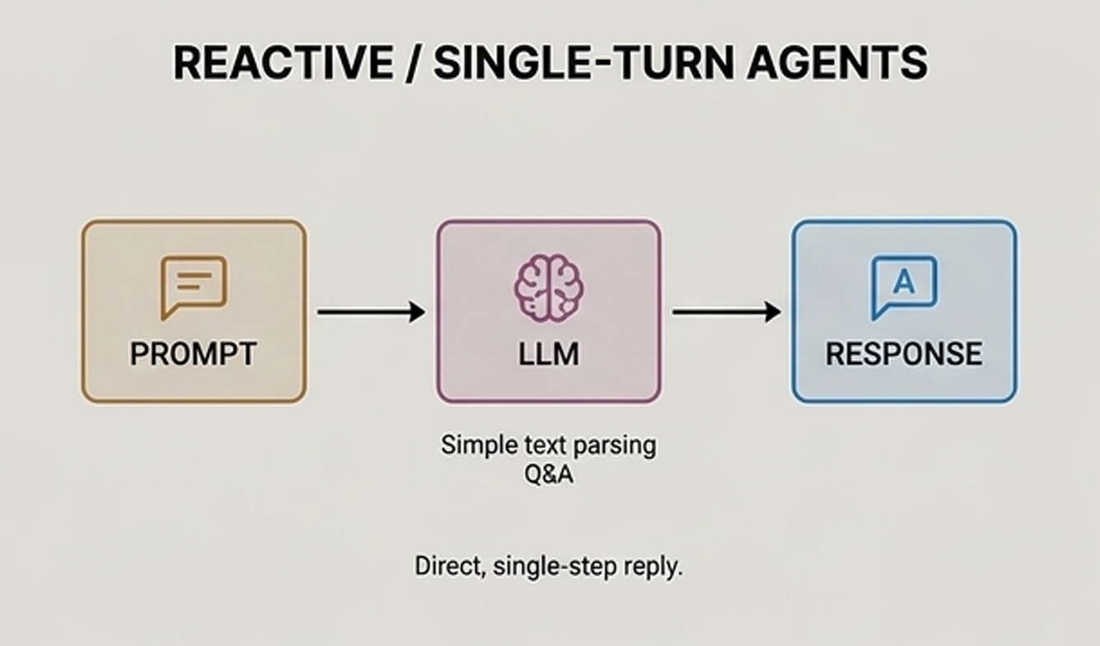
Types of AI Agent
1. Reactive / Single-Turn Agents
2. Tool-Calling Agents
These ai agents respond strictly to one prompt at a time without multi-step foresight. They rely on simple text parsing, direct Q&A, and quick context matching. These agents do not maintain implicit state across sessions or perform long-term planning, making them highly efficient for immediate, single-step resolutions.
These ai agents use the LLM to decide when and how to call external services. They can call APIs (e.g., weather, stocks), query databases, or execute math. These agents bridge the gap between parametric knowledge and real-time external data execution.
Example Use Cases: Basic customer support chatbots, simple text summarization.
Example Use Cases: Real-time data retrieval assistants, Booking & Scheduling Assistants, etc

Slide 4
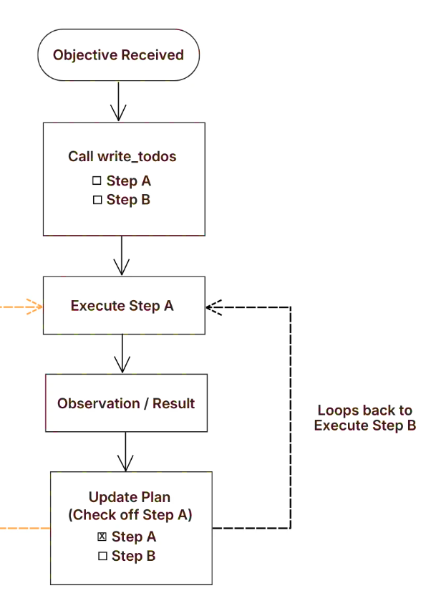
Types of AI Agent (Cont.)
3. Goal-Oriented / Autonomous Agents
Given a high-level goal, they independently break it down into a multi-step plan. Goal-based ai agents have an internal model of the world and also a goal or set of goals. These agents search for action sequences that reach their goal and plan these actions before acting on them.
This search and planning improve their effectiveness when compared to other simple ai agents.
They maintain persistent memory and adapt their strategies based on intermediate outcomes to ensure successful goal completion.
Example Use Cases: Comprehensive market research, autonomous end-to-end software testing, etc

Slide 5


Architectures
Workflow vs Autonomous Agent Design Patterns
Workflow Patterns
Autonomous Agent Pattern
Execution paths, step ordering, and condition gates are explicitly defined in code. LLM calls serve as reliable processing nodes within the system pipeline. [6]
The agent autonomously determines its execution path based on environment feedback, goal planning, reflection, and tool execution. [6]
■
Higher predictability and testability
■
High adaptability to open-ended goals
■
Lower latency and controlled token expenditure
■
Dynamic tool selection and runtime recovery
■
Ideal for standardized, step-by-step transformations
■
Handles complex multi-step reasoning environments
Primary Patterns: Prompt Chaining, Sequential Workflows, Routing, Parallelization, Orchestrator-Workers, Evaluator-Optimizer.
Primary Patterns: ReAct (Reason+Act), Planning Agents, Reflection / Self-Critique, Multi-Agent Collaboration.

Slide 6

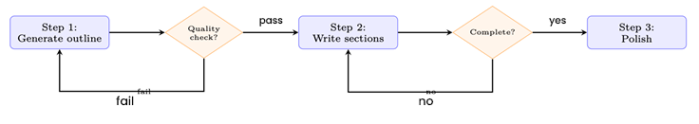

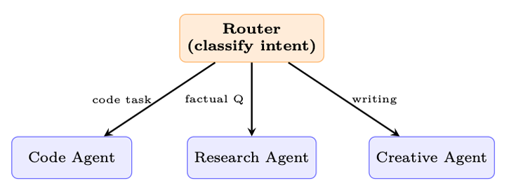
Workflow Patterns
1. Prompt Chaining
Decomposes a task into a fixed sequence of LLM calls where the output of one step becomes the input context for the next, with validation gates, ensuring higher precision and intermediate quality control at each stage. [6]
When to use: Tasks that are naturally sequential—content generation, data transformation, multi-stage analysis.
Use Cases: Multi-stage reasoning, document analysis, data transformation.
Fig: Prompt chaining with quality gates. Each step is a separate LLM call. Gates can be LLM-based or programmatic.[6]
2. Routing
Uses an initial router or classifier to direct incoming requests to specialized agents or processing paths with tailored prompts and tools , optimizing latency and cost by serving simple requests quickly and reserving larger, specialized models for complex tasks. [6]
When to use: Distinct task types with different optimal prompts, tools, or models. Customer support triage, multi-modal input handling.
Use Cases: Customer support triage, query classification
Fig: Routing pattern: input is classified once, then handled by a specialist. [6]

Slide 7

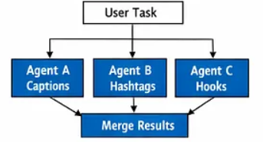
Workflow Patterns (Cont.)
4. Parallelization
Distributes independent subtasks across concurrent LLM calls. Executes simultaneously and aggregates outputs to reduce total system latency , making it ideal for independent evaluation tasks, majority-voting consensus mechanisms, and multi-perspective verification. [6]
It has two sub-patterns:
Sectioning (fan-out): Partition the input into disjoint chunks and process each independently— e.g., run security, performance, and style checks on a codebase simultaneously.
Voting (redundancy): Issue the same prompt N times with different seeds or temperatures, then select the best result via majority vote [368], reward-model scoring, or LLM-as-judge.
Use Cases: Multi-aspect code reviews, guardrail checks.

Slide 8


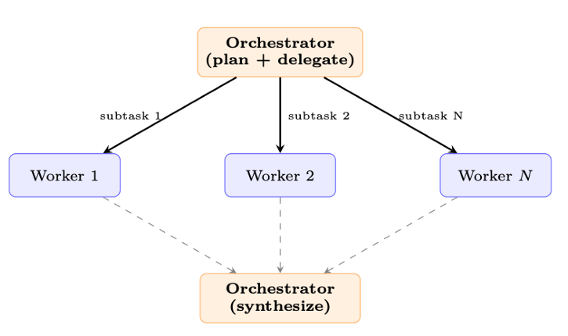
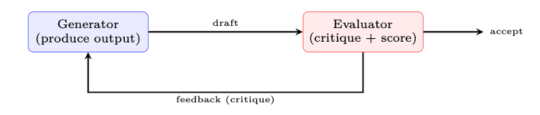
Workflow Patterns (Cont.)
5. Orchestrator–Workers
6. Evaluator–Optimizer
A central LLM dynamically analyzes a task, breaks it down into subtasks, delegates to specialized worker agents, and synthesizes the collected worker outputs into a final result. [6]
Creates an iterative loop where a Generator LLM produces output and an Evaluator LLM assesses it against quality criteria, providing actionable feedback until thresholds are met.[6]
When to use: Tasks with clear quality criteria—code that must pass tests, translations that must preserve meaning, writing that must match a style guide.
Fig: Evaluator-optimizer: iterative refinement without training.[6]
Fig: Orchestrator-workers: the LLM decides how to decompose the task and synthesizes worker results. [6]
Example Use Cases: Code generation with test pass verification, high-stakes translation,
Example Use Cases: Complex software development, multi-domain compliance analysis.

Slide 9


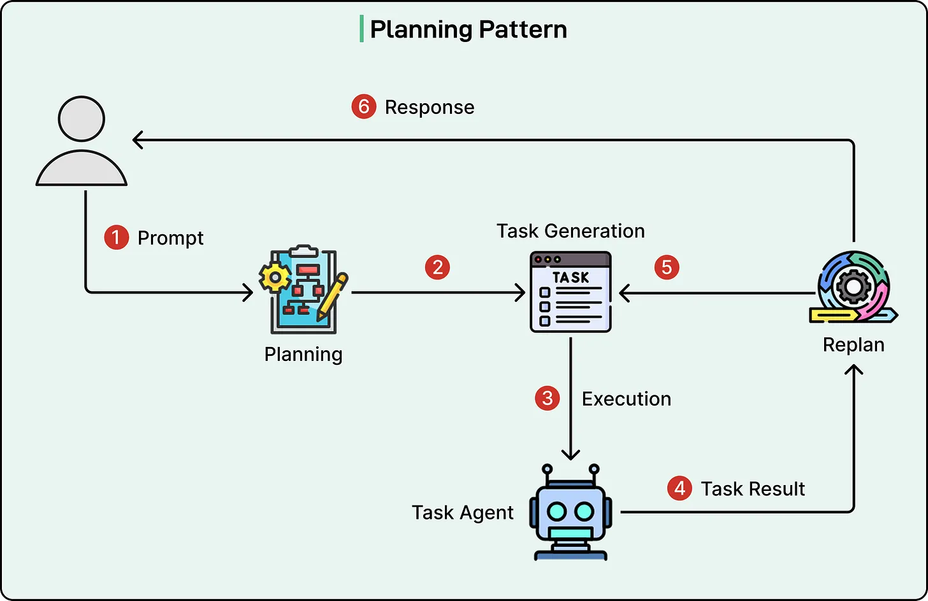
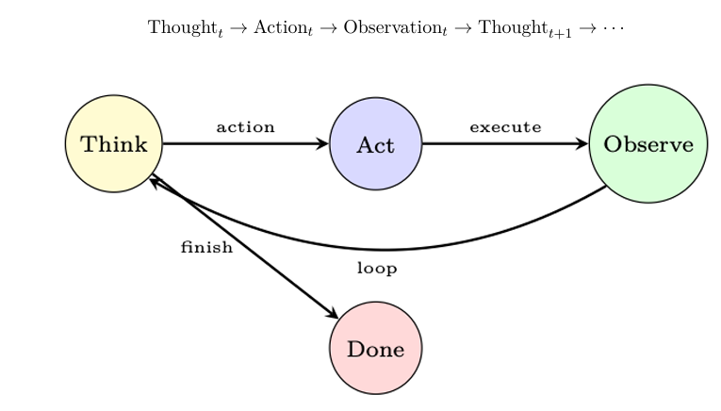
Autonomous Agent Patterns
Systems where the LLM-Based Agent independently determines execution paths, tool selection, reflection loops, and agent collaboration.
1. ReAct (Reason & Act)
2. Planning Agent
It combines reasoning and action in a dynamic, iterative loop where a single agent observes the environment, formulates a plan, executes an action using available tools or APIs, and evaluates the resulting feedback to decide the next step. By constantly re-evaluating its context, the model can course-correct on the fly, retry failed tool calls, or adjust its strategy based on intermediate outputs. [6]
It generates an explicit plan for achieving a goal before beginning execution. The plan contains tasks and dependencies, while the agent can revise the plan when new information, failures, or unexpected results are encountered during execution.[6]
Example Use Cases:
Q&A, Code generation & debugging
Example Use Cases:
Content generation, document analysis, data transformation

Slide 10


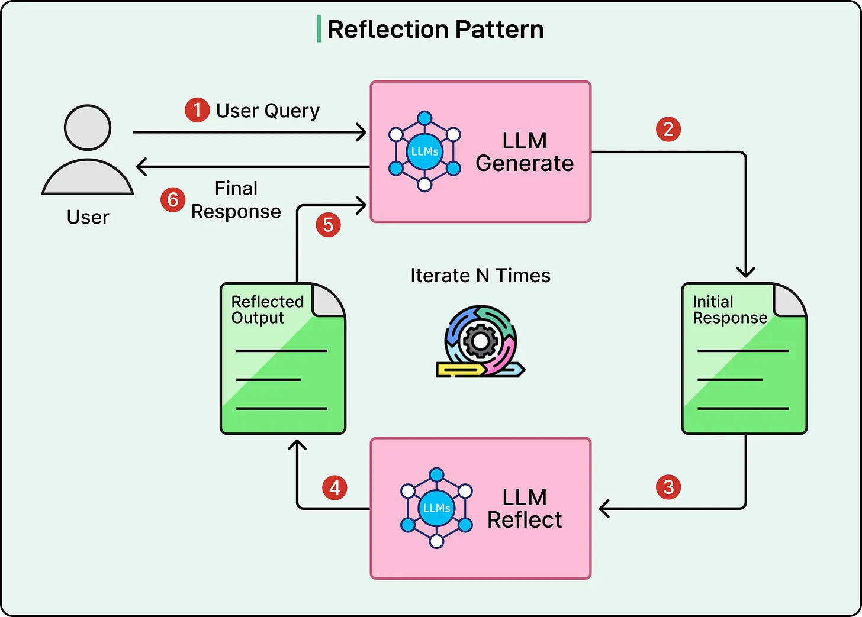
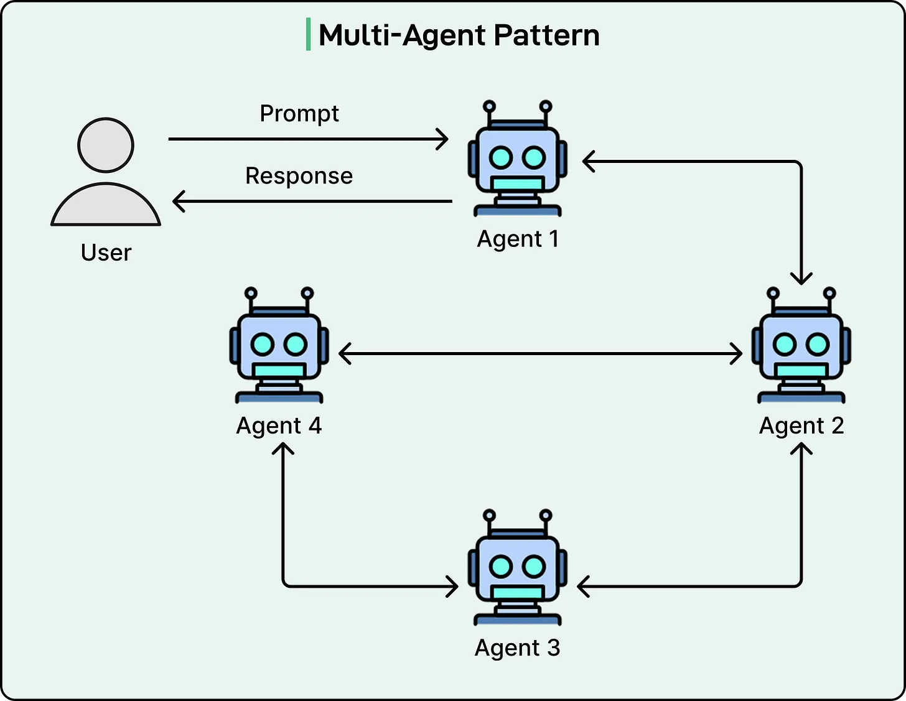
Autonomous Agent Patterns (Cont.)
Systems where the LLM-Based Agent independently determines execution paths, tool selection, reflection loops, and agent collaboration.
3. Reflection & Self-Critique
4. Multi-Agent Swarm
It introduces a self-evaluation stage where the agent examines its previous actions or output, identifies errors or inefficiencies, and modifies its strategy. The reflection can also be stored as memory and reused during subsequent attempts [6]
A Multi-Agent Swarm relies on a manager agent to orchestrate a ecosystem of domain-expert sub-agents working together toward a high-level goal. The manager breaks down complex user objectives into specific tasks and assigns them to specialized roles—such as a Coder for implementation, a Researcher for context gathering, and a Reviewer for quality assurance—who can debate, review each other's work, and iteratively refine deliverables. [6]
Customer support automation
Software development teams, Threat analysis & support
Example Use Cases:
Example Use Cases:

Slide 11
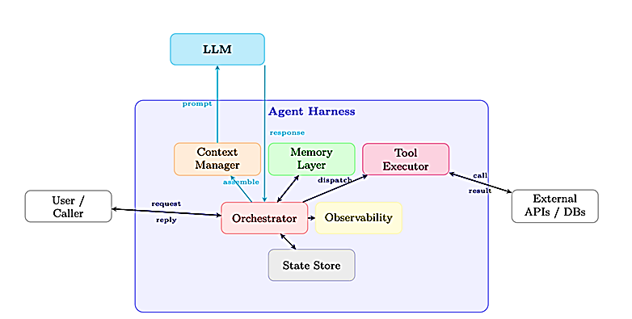
Harness Engineering
An LLM alone is not sufficient for reliable long-running software development. Harness Engineering focuses on designing the surrounding environment—context, tools, memory, state, constraints, verification, and feedback loops—so agents can effectively execute complex tasks.[14]
There are things we want an agent to do that a model cannot do out of the box. This is where a harness comes in. A harness is every piece of code, configuration, and execution logic that isn't the model itself. A raw LLM model is not an agent. But it becomes one when a harness gives it things like state, tool execution, feedback loops, and enforceable constraints. [19]
Concretely, a harness includes things like:
System Prompts
Tools, Skills, MCPs + and their descriptions
Bundled Infrastructure (filesystem, sandbox, browser)
Orchestration Logic (subagent spawning, handoffs, model routing)
Hooks/Middleware for deterministic execution (compaction, continuation, lint checks)
Agent = Model + Harness

Slide 12
Harness Engineering
In simple terms, harness engineering is the practice of designing the full environment that an AI agent operates within: the rules it follows, the checks it must pass, and the feedback loops that prevent the same mistake from recurring.
The harness enforces a clean separation of concerns:
Reasoning: Delegated entirely to the LLM; the harness does not second-guess model outputs.
Execution: The harness dispatches tool calls, manages I/O, and enforces sandboxing.
Memory: The harness maintains short-term (context window), working (scratchpad), and long-term (vector store / database) memory.
Communication: The harness handles message routing between agents, users, and external services.
Observability: The harness instruments every step for logging, tracing, and debugging [6]
Why Separate Concerns?
A language model is a function f_{θ} : tokens → tokens. It has no persistent state, no ability to call APIs, and no awareness of time. The harness is the “operating system” that gives the model a body—persistent memory, actuators (tools), and a scheduler (orchestrator). Just as an OS abstracts hardware from applications, the harness abstracts infrastructure from the model [6]

Slide 13
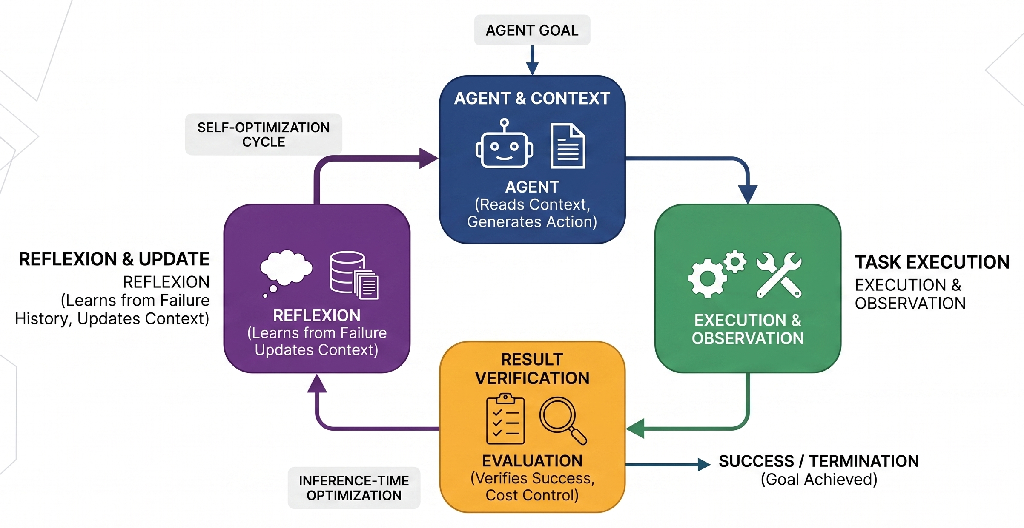
Loop Engineering
The Orchestration Harness coordinates everything: it decides when to retrieve, when to call tools, when to delegate to sub-agents, and when to ask the human for guidance, whereas Loop Engineering formalizes the harness’s retry-and-verify cycles as inference-time optimization, ensuring convergence and cost control.
It reflects a structural reality: When a single agent run may last an hour and modify dozens of files, the highest-leverage engineering is no longer in the prompt—it is the Loop that keeps the agent productive, verified, and on-goal throughout. [6]
From Prompt to Loop: The Engineering Progression[6]
1. Prompt engineering: Optimize what you say to the model (2022–24)
2. Context engineering: Optimize everything the model sees (2025)
3. Harness engineering: Optimize the environment the agent runs in (2025–26)
4. Loop engineering: Optimize the cycle that keeps the agent working toward a goal (2026)

Slide 14
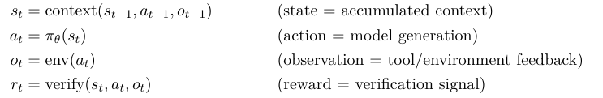
Loop Engineering
Reflection in Practice (Reflexion)
Example: After three failed attempts to solve a coding problem, the agent reflects:
Retrieves the three failure episodes from episodic memory.
Generates an insight: “I keep forgetting to handle the edge case where the input list is empty.”
Stores this insight in semantic memory.
On the next attempt, retrieves the insight and explicitly checks for empty inputs.
This is the core mechanism of Reflexion; learning via self-reflection. [6]
A well-engineered agent loop is structurally identical to an RL optimization process operating at inference time—without gradient updates to the model weights:
The loop continues until r_{t} exceeds a success threshold or a termination condition triggers. The “policy” π_{θ} is not updated via gradients; instead, the state is updated—observations, error messages, and reflections are appended to the context, conditioning the same frozen model to produce better actions on subsequent iterations. This is precisely the mechanism behind Reflexion, the model improves across iterations not by learning new weights but by reading its own failure history. [6]
Harness Engineering provides the controlled environment around agents—giving them the right context, tools, permissions, testing, guardrails, and observability for reliable execution. Loop Engineering enables continuous autonomous operation by repeatedly discovering tasks, executing them, verifying results, learning from feedback, and re-planning when needed. Together, they can make our Autonomous SDLC more reliable, adaptive, and self-correcting.

Slide 15
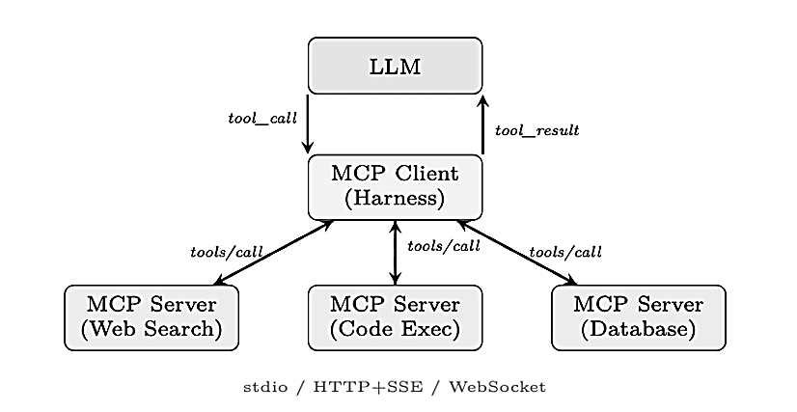
MCP & Why Do We Need It?
The Core Problem: Every time a new LLM agent framework appears, developers must re-implement connectors to the same tools: file systems, databases, web search, code execution, calendar APIs. This is wasteful, error-prone, and creates a maintenance burden that scales quadratically with the number of agents and tools.
Also LLM knowledge is frozen at training time & LLMs Agents cannot inherently interact with the outside world (real-time data, business systems, APIs).
The Solution (MCP): The Model Context Protocol is an open standard that enables developers to build secure, two-way connections between their data sources and AI-powered tools. The architecture is straightforward: developers can either expose their data through MCP servers or build AI applications (MCP clients) that connect to these servers [18]
Here is a simplified look at how MCP would handle this:
1. Discover Tools: AI realizes it needs external help and finds the database and email tools registered on MCP.
2. Fetch Data: AI requests the sales report via MCP; the database server fetches and returns the report.
3. Send Email: AI hands the report to the email tool, which sends it to the manager.
4. Confirm: AI tells you the task is finished. [18][6]
Fig: MCP architecture. The harness acts as an MCP client, routing tool calls to specialized MCP servers over standardized transports.[6]

Slide 16
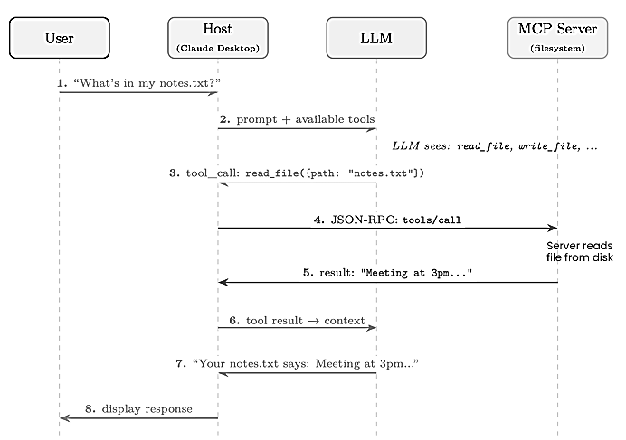
How MCP works:
Fig: A single user request flows through the Host, LLM, and MCP Server.
The LLM decides which tool to call (step 3);
the Host routes the call to the appropriate server via JSON-RPC (step 4);
the result flows back through the LLM for natural-language formatting (steps 5–7).
The user never sees the protocol machinery. [6]

Slide 17
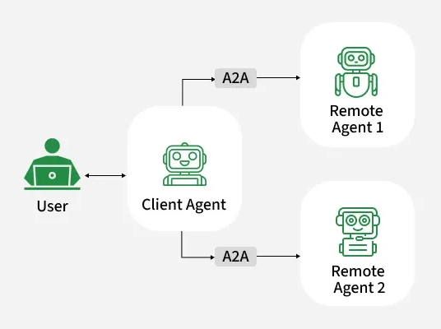
Agent-to-Agent Communication (A2A)
The Core Problem: As large language models evolve from isolated assistants into collaborative networks of specialized agents, the question of how agents talk to each other becomes as important as how they reason internally.
The Solution (A2A): In April 2025, Google (with contributions from over 50 technology partners) released the Agent to-Agent (A2A) Protocol [113], an open specification for interoperable communication between AI agents. [6]
A2A is built on five core principles:
Opaque Execution: Agents interact through defined interfaces without needing to know how another agent works internally.
Enterprise Ready: Supports authentication, security, auditing, and compliance.
Modality Agnostic: Supports text, files, and structured data.
Built on Standards: Uses common protocols such as HTTP, JSON-RPC, SSE, and gRPC.
Async-First: Supports long-running tasks through polling and notifications without keeping connections open. [6]

Slide 18
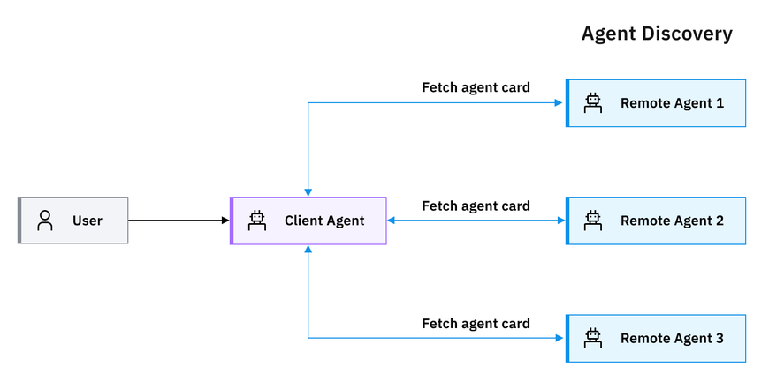
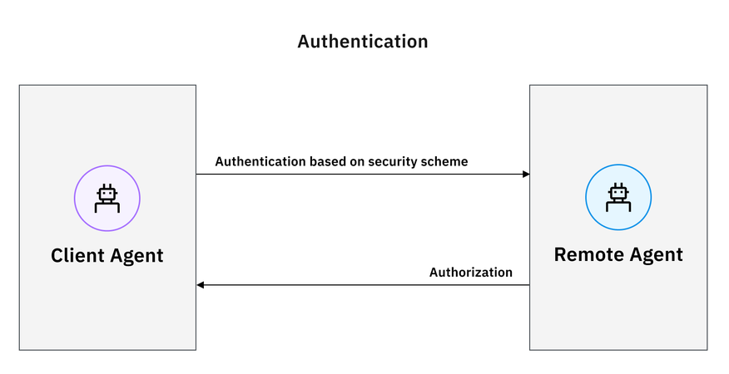
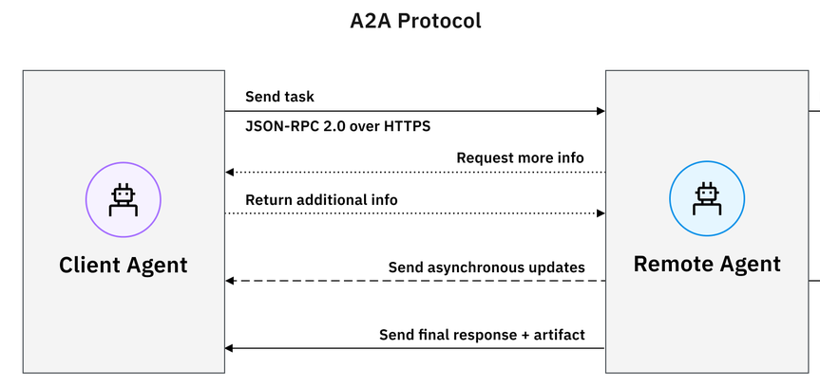
Agent-to-Agent Communication (A2A)
The A2A protocol follows a client-server model setup with a three-step workflow [12]:
Discovery
Authentication
Communication
1. The A2A workflow begins when an entity initiates a request to the client agent. A client agent then discovers/looks for remote agents and fetching their agent cards to determine the best fit for the task. [12]
2. Once the client agent identifies a remote agent capable of fulfilling the designated task, it then goes through authentication according to the security scheme (such as API keys, OAuth 2.0) indicated in the agent card.[12]
3. Communication starts with a client agent sending a task to the chosen remote agent. Agent-to-agent communication occurs over HTTPS for secure transport, with JSON-RPC (Remote Procedure Call) 2.0 as the format for data exchange. [12]

Slide 19
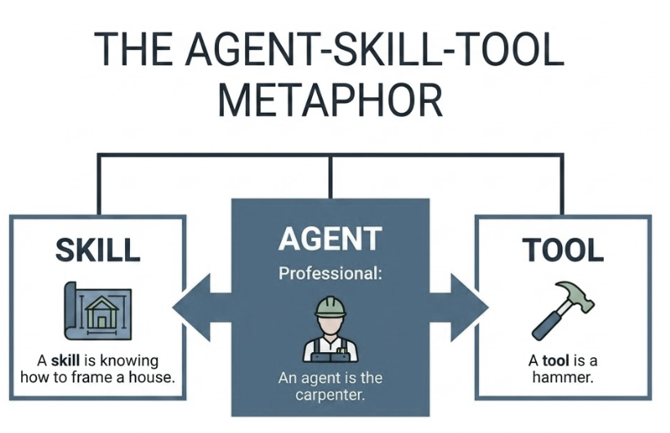
Agent Skills: Composable Capabilities
What Is a Skill?
A skill is a self-contained capability module that gives an agent expertise in a specific domain or task. Unlike a raw tool (which exposes a single function), a skill encompasses:
System prompt augmentation: Domain-specific instructions, constraints, and persona elements injected into the agent’s context.
Tool bindings: One or more tools the skill requires (APIs, MCP servers, local commands).
Knowledge: Reference material, examples, or few-shot demonstrations the agent needs to execute the skill correctly.
Workflow logic: Multi-step procedures, decision trees, or conditional flows that guide the agent through complex tasks.
Guardrails: Skill-specific safety constraints, output format requirements, and validation rules. [6]

Slide 20
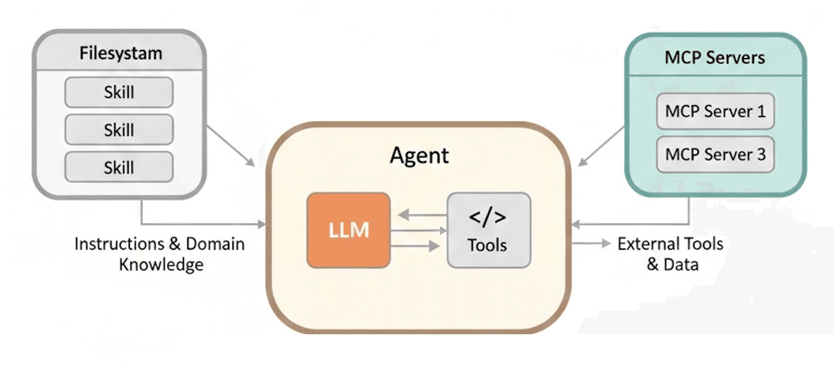
Agent Skills (Cont.)
# Pre-defined skill
code_review = Skill(
name="CodeReview",
instructions="Review code for correctness, security and quality.",
knowledge=["coding_standards", "security_guidelines"],
tools=["static_analyzer", "test_runner"],
workflow=["analyze", "test", "report"],
guardrails=["verified_findings", "structured_output"]
)
# Agent
developer_agent = Agent(
name="Developer",
model="LLM",
skills=[code_review],
memory="project_memory"
)
# Agent uses the skill
result = developer_agent.run(
skill="CodeReview",
input=repository
)
Here is a pseudo-representation of a pre-defined AI Skill declaration and its invocation by an Agent.
The Skill encapsulates domain-specific instructions, knowledge, tools, workflow logic, and guardrails into a reusable capability. The Agent can select and invoke the Skill when the corresponding task is required.

Slide 21
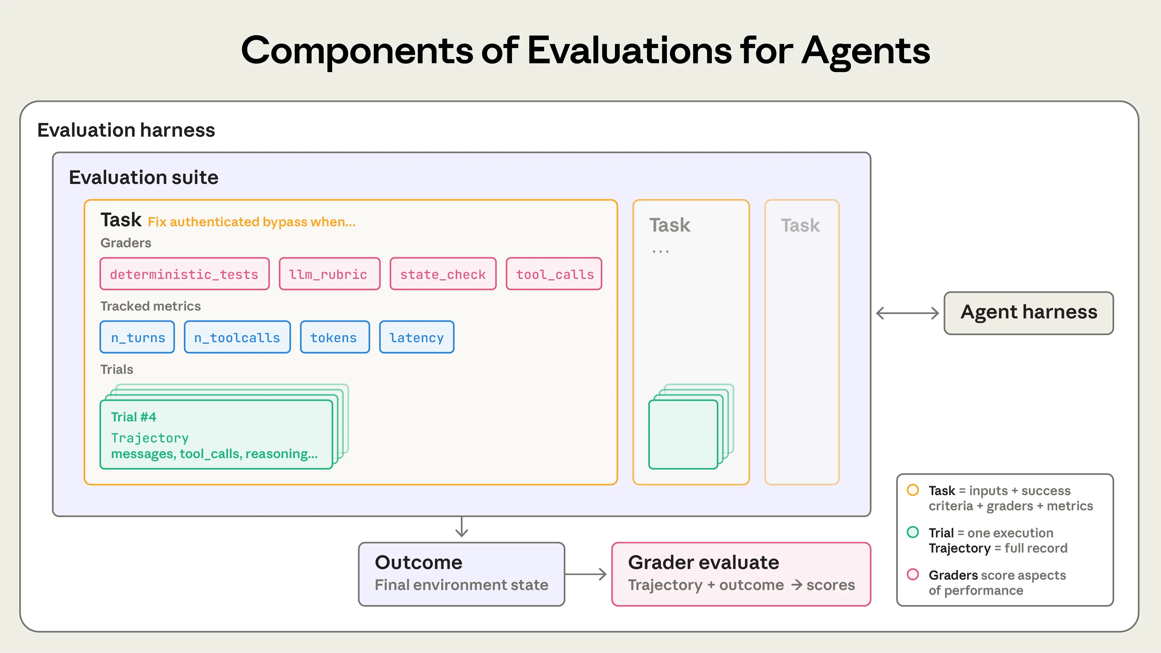
Evaluating the Ai Agents
The important finding from current agent-evaluation literature is that agent evaluation must assess more than the final answer. Agents act over multiple steps, use tools, modify state, and can fail in different places. Anthropic explicitly recommends evaluating the task, trajectory/transcript, and final environment outcome, with multiple trials because agent behavior is variable.
For agents, the evaluation should examine:
What the agent produced
How it acted
Whether the task actually succeeded
How efficiently and safely it behaved. [20]
DeepEval is an open-source evaluation framework used by developers to unit-test, trace, and score Large Language Model (LLM) applications and AI agents. For AI agents, it goes beyond simple input-output checks to evaluate complex multi-step reasoning, tool selection, and overall task execution trajectories [21]
DeepEval simplifies building an Evaluation Harness, an evaluation harness is the infrastructure that runs evals end-to-end. It provides instructions and tools, runs tasks concurrently, records all the steps, grades outputs, and aggregates results.

Slide 22
Evaluating the Ai Agents (Cont.)
An evaluation suite is a collection of tasks designed to measure specific capabilities or behaviors. Tasks in a suite typically share a broad goal. For instance, a customer support eval suite might test refunds, cancellations, and escalations.[20]
It supports 10+ popular agent frameworks : LangChain, LangGraph, OpenAI Agents, Pydantic AI, CrewAI, Google ADK, and more.[21]
When building agent evaluations, we use the following definitions:
A task (a.k.a problem or test case) is a single test with defined inputs and success criteria.
Each attempt at a task is a trial. Because model outputs vary between runs, we run multiple trials to produce more consistent results.
A grader is logic that scores some aspect of the agent’s performance. A task can have multiple graders, each containing multiple assertions (sometimes called checks).
A transcript (also called a trace or trajectory) is the complete record of a trial, including outputs, tool calls, reasoning, intermediate results, and any other interactions.
The outcome is the final state in the environment at the end of the trial. [20]
AI agents consist of interconnected layers that each require distinct evaluation approaches: [21]
Layer | What It Does | Evaluation Scope | Key Metrics
Reasoning Layer | Plans tasks, creates strategies, decides what to do | Trajectory | PlanQualityMetric, PlanAdherenceMetric
Action Layer | Selects tools, generates arguments, executes calls | Component-level | ToolCorrectnessMetric, ArgumentCorrectnessMetric
Execution Layer | Orchestrates the full loop, completes objectives | Trajectory | TaskCompletionMetric, StepEfficiencyMetric

Slide 23
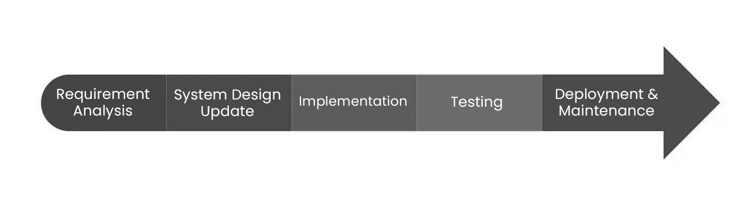
The Traditional SDLC
The Traditional Software Development Life Cycle (SDLC) is the structured framework that engineering teams follow to plan, design, build, test, and deploy software applications from initial concept.
This Manual SDLC execution creates severe friction—engineers waste most of their time on administrative handoffs, environment setups, regression testing, and ticketing overhead instead of writing core logic.[5]
So, Our Aim is to automate the Traditional SDLC with Agentic AI, which will replaces these static bottlenecks with continuous, self-healing pipelines that autonomously execute tests, patch build failures, flag vulnerabilities, and manage releases. This eliminates human error, compresses cycle times from months to hours, and frees development teams to focus on high-value architecture and innovation.

Slide 24







Proposed Architecture: Modular Pipeline
A modular pipeline with integrated Human-in-the-Loop (HITL) governance gates to ensure enterprise safety.
Requirement Engineering
Planning
HITL Approval
Continuous Loop
7. Monitoring & Learning: Consumes production logs, metrics, and user feedback to detect errors and optimize prompts.
Architecture & Design
HITL Approval
Development
8. Organizational Memory: Captures all requirements,
code, reviews, and bug fixes into a Knowledge Graph for cross-sprint learning.
Verification (Quality Assurance (Testing)/Security)
HITL Approval
Deployment
HITL Approval

Slide 25
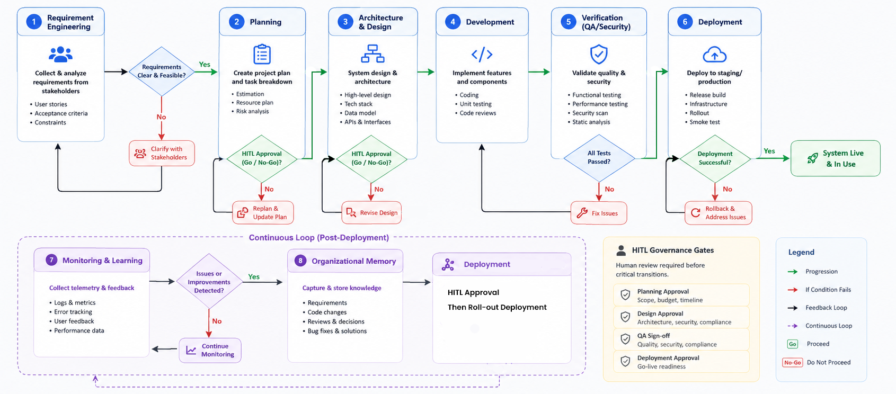
Proposed Architecture: Modular Pipeline

Slide 26






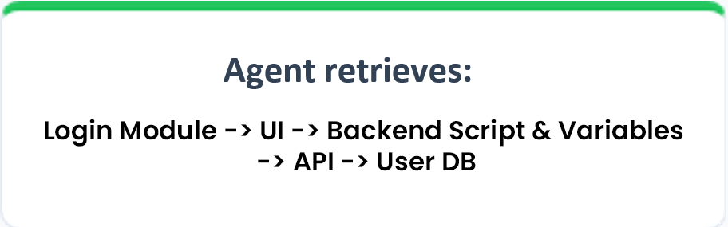
Core Innovation: Hierarchical Software Knowledge Graph (HSKG)
Project Graph
Context-Aware
Beyond Traditional Memory:
A Context-Aware Project Memory
Project
Instead of:
├
Authentication Login, Register
The Problem: Current AI agents retrieve entire repositories or large documents, resulting in high token consumption and irrelevant context. [1]
├
Inventory Product, Stock
└──
Invoice Create, Payment
Our Solution: Our proposed HSKG stores the software project as a hierarchical graph, enabling agents to retrieve only the smallest relevant subgraph required for a task.
Purpose
Represents the complete SDLC structure
Maintains hierarchy between project components
Enables modular navigation
Benefits
Minimal context
Lower token usage
Faster reasoning
Better accuracy
Reduced hallucination

Slide 27
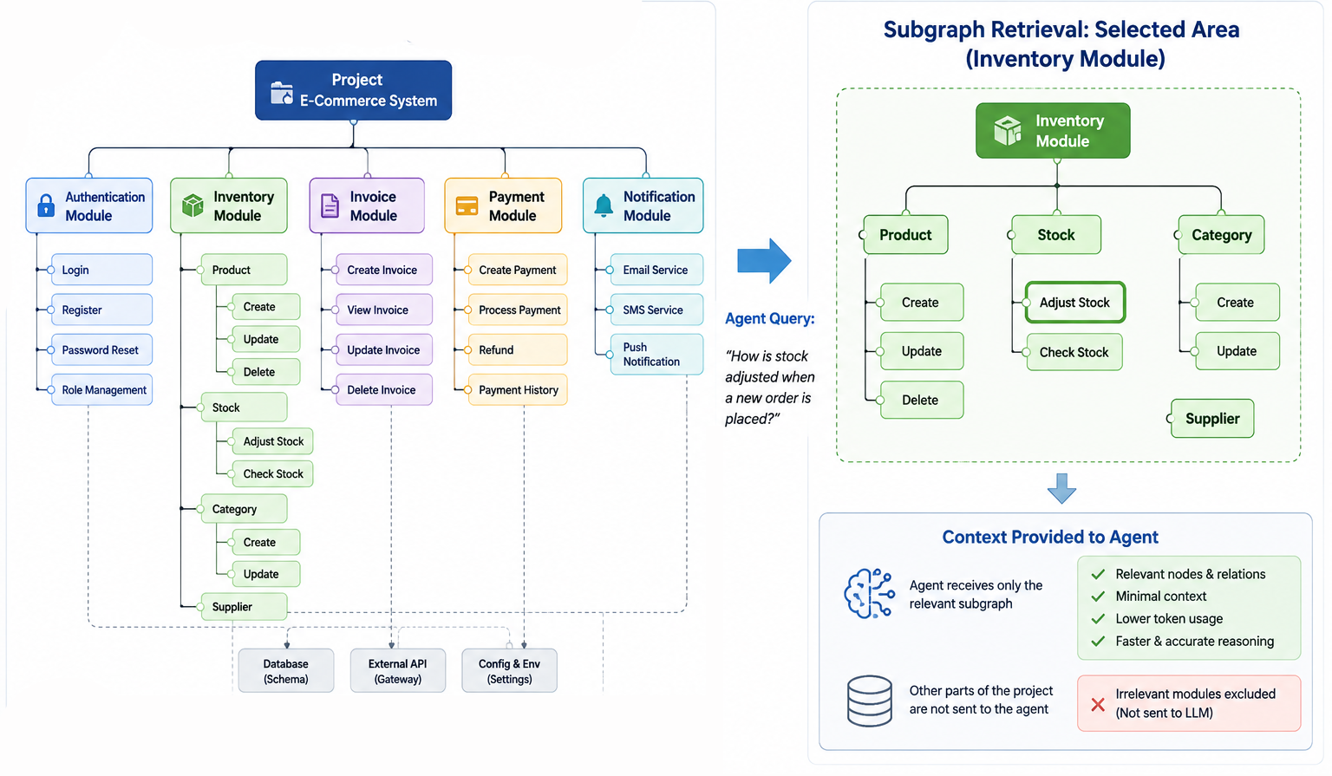
Core Innovation: Hierarchical Software Knowledge Graph (HSKG)

Slide 28


Existing SDLC Automations
While existing autonomous systems are highly capable at code execution, they lack long-term organizational memory and struggle with end-to-end orchestration.
System | Requirements | Architecture | Coding & Test | Deployment | Org. Memory
Devin AI [15] | Partial, Prompt-driven only | Partial, Ad-hoc planning | Yes, Autonomous execution | Partial, Sandboxed environments | No, Session-limited context
MetaGPT [11] | Yes, Multi-agent parsing | Yes, Structured PRD generation | Partial, Lacks dynamic env. feedback | No, Manual intervention req. | Partial, Static file-based memory
GitHub Copilot Workspace[13] | Partial, Spec/Issue refinement | Partial, File-level plan generation | Yes, Autonomous code generation & test runs | No, Hands off at PR stage | Partial, Repository & PR history context
Proposed System | Yes, Interactive elicitation | Yes, Context-aware design | Yes, Agentic orchestration | Yes, CI/CD pipeline integrated | Yes, Long-term vector, HKG, retrieval
Source: Compiled from official documentation and validated using publicly available implementation benchmarks.

Slide 29
Agentic Frameworks
Framework | Execution Model | Core Strengths | Key Limitations | Ideal Use Cases | Local / Offline
LangChain [7] | Linear chains & tool pipelines | Large integration ecosystem; RAG & tool abstraction; rapid development | High abstraction; limited control over complex loops; state management can become cumbersome | RAG, Q&A, tool-based LLM apps | ⭐⭐⭐⭐⭐ Excellent — Ollama, llama.cpp, Chroma, Qdrant
LangGraph [8] | Stateful graph with cycles & conditional flows | Fine-grained state control; checkpointing; fault tolerance; complex loops | Steeper learning curve; more setup; explicit state management | Complex agents, multi-agent systems, SDLC automation, HITL | ⭐⭐⭐⭐⭐ Excellent — self-hosted models & local stores
CrewAI [9] | Role-based sequential / hierarchical teams | Simple agent-role abstraction; delegation; fast multi-agent prototyping | Less flexible for highly dynamic workflows; coordination overhead | Multi-agent research, content teams, structured workflows | ⭐⭐⭐⭐ Strong — Ollama, LiteLLM, vLLM
OpenAI Agents SDK [10] | Handoffs, tools & guardrail-driven execution | Simple abstractions; guardrails; tracing; agent handoffs; sandbox support | Limited built-in long-term memory/graph persistence; ecosystem-oriented conventions | Multi-agent services, real-time/voice agents, sandboxed coding | ⭐⭐⭐⭐ Very Good — local models through compatible endpoints
Source: Compiled from official model documentation and validated using publicly available implementation benchmarks and deployment experiences.

Slide 30
Local Offline Execution Strategy
Deploying via offline models ensures data privacy. Model selection is based on VRAM footprint, Training data freshness, Suitable for Agentic Operations.
Models | Approx. VRAM | Context Window | Best Use Case
Mistral Small 3.2 24B | ~15–17 GB | 128K | General agents, planning, tool use
Qwen3 30B-A3B | ~18–20 GB | 32K | Orchestrator, planning, reasoning
Qwen2.5-Coder 32B | ~18–20 GB | 128K | Developer, coding & debugging
Qwen3 32B | ~19–22 GB | 32K | Architect, reasoning, complex agents
Gemma 4 31B | ~19–21 GB | 256K | Multimodal, coding, reasoning & agents
Source: Compiled from official model documentation and validated using publicly available implementation benchmarks and deployment experiences.

Slide 31
Conclusion
We propose an Autonomous Software Development Lifecycle (A-SDLC) framework that transforms traditional software development into an AI-orchestrated, adaptive engineering process.
Instead of relying on isolated coding assistants, the framework coordinates specialized AI agents, reusable skills, persistent project memory (HSKG), tools, and feedback loops across the complete SDLC—from requirements and architecture to development, testing, deployment, and continuous improvement.
Expected Outcomes
End-to-end SDLC automation through coordinated specialized agents
Context-efficient development through HSKG-based selective retrieval
Reliable and adaptive execution through harnesses, verification, and feedback loops
Improved traceability of requirements, decisions, code, tests, and changes
Reusable engineering knowledge through persistent project memory and skills
Reduced repetitive human effort while retaining human oversight for critical decisions
The goal is not to replace software engineers, but to build an AI-orchestrated engineering system that can continuously plan, execute, verify, and improve software development.

Slide 32
References
Articles & Official Documentations
Research Papers & Book
[7] LangChain Documentation.
[8] LangGraph Documentation.
[9] CrewAI Documentation.
[10] OpenAI Agents SDK Documentation.
[11] Hong, S., et al. (2024). MetaGPT: Meta Programming for Multi-Agent Collaborative Framework.
[12] IBM: https://www.ibm.com/think/topics/agent2agent-protocol
[13] GitHub. "Copilot Workspace: AI-Native Developer Environment.": https://githubnext.com/projects/copilot-workspace/
[14] OpenAi - https://openai.com/index/harness-engineering/
[15] Cognition AI – Devin: AI Software Engineer.
[16] Microsoft Copilot: Microsoft-copilot/for-individuals/do-more-with-ai/general-ai/understanding-ai-agents-vs-chatbots?
[17] IBM: https://www.ibm.com/think/topics/ai-agents
[18] Google Cloud: cloud.google.com/discover/what-is-model-context-protocol
[19] Langchain: https://www.langchain.com/blog/the-anatomy-of-an-agent-harness
[20] Anthropic: https://www.anthropic.com/engineering/demystifying-evals-for-ai-agents
[21] DeepEval: https://deepeval.com/guides/guides-ai-agent-evaluation
[1] He, J., Treude, C., & Lo, D. (2025). LLM-Based Multi-Agent Systems for Software Engineering: Literature Review, Vision... ACM TOSEM.
[2] Apostolou, S. A., et al. (2026). Assistance to Autonomy: A Systematic Literature Review of Agentic AI across the SDLC. arXiv.
[3] Agentic AI in the Software Development Lifecycle: Architecture, Empirical Evidence... (2026). arXiv.
[4] Veselka Sasheva Petrova-Dimitrova, “Classifications of intelligence agents and their applications,” Fundamental sciences and applications, Vol. 28, No. 1, 2022.
[5] Sommerville, I. Software Engineering (10th Edition).
[6] The Hitchhiker's Guide to Agentic AI: From Foundations to Systems by
Haggai Roitman

Slide 33
"
Thank You

